Slide 1
Currency Converter
Mini Project [Group No: 16]
Arshad Khan – 20CO24
Tayyab Shaikh – 20CO50
Taabish Gazi – 20CO20

Slide 2
Table of Contents
Introduction
Objective
Algorithm
Flowchart
Methodology
References

Slide 3
Introduction
Currency converter is a tool used to convert one country’s currency to another.
In this project by the knowledge of currency converter a program is designed in python language.
In this Currency Converter application, it is going to display a web application where you can choose to display the converter or the exchange rate of one currency with all other currencies in the form of dropdown. In the converter you are given a choice to choose two currency names from the list of currency names displayed.

Slide 4
Objective
The main objective is to develop a currency converter for major countries in the world. The Currencies to be used here are Indian Rupees (INR), Canadian Dollar (CAD), Euro (EUR), Danish Krone (DKK), Chinese Yuan (CNY) and US Dollar (USD). To achieve this objective, specific objectives are laid out which include:
i. Develop a system which able to convert between the currencies mentioned above.
ii. A system in which an exchange rate for any particular currency can be stored and used in conversion between the correspondent currency.

Slide 5
Algorithm
Step1: Start
Step2: Enter the amount value
Step3: Select the currency from and to
Step4: Click on the convert button
Step5: The value will be displayed
Step6: Exit

Slide 6
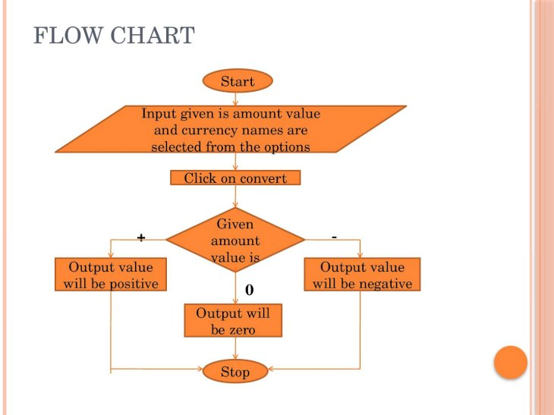
Flowchart

Slide 7
Methodology
Importing the module – tkinter
Create the main window (container)
Add any number of widgets to the main window.
Apply the event Trigger on the widgets.
Adding Entry widgets to the main window to take user input.
Creating Functions to perform calculations.
Adding Buttons to the main window.

Slide 8
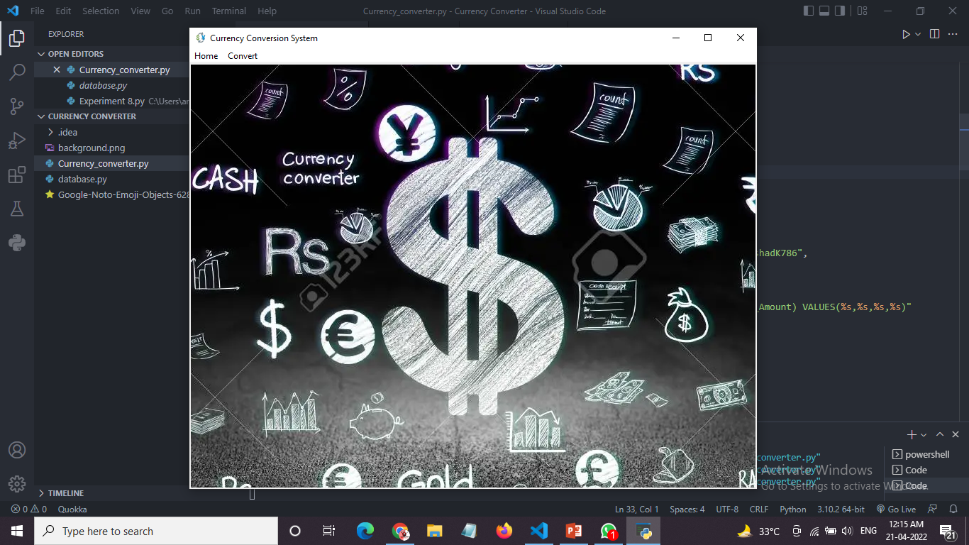

Slide 9
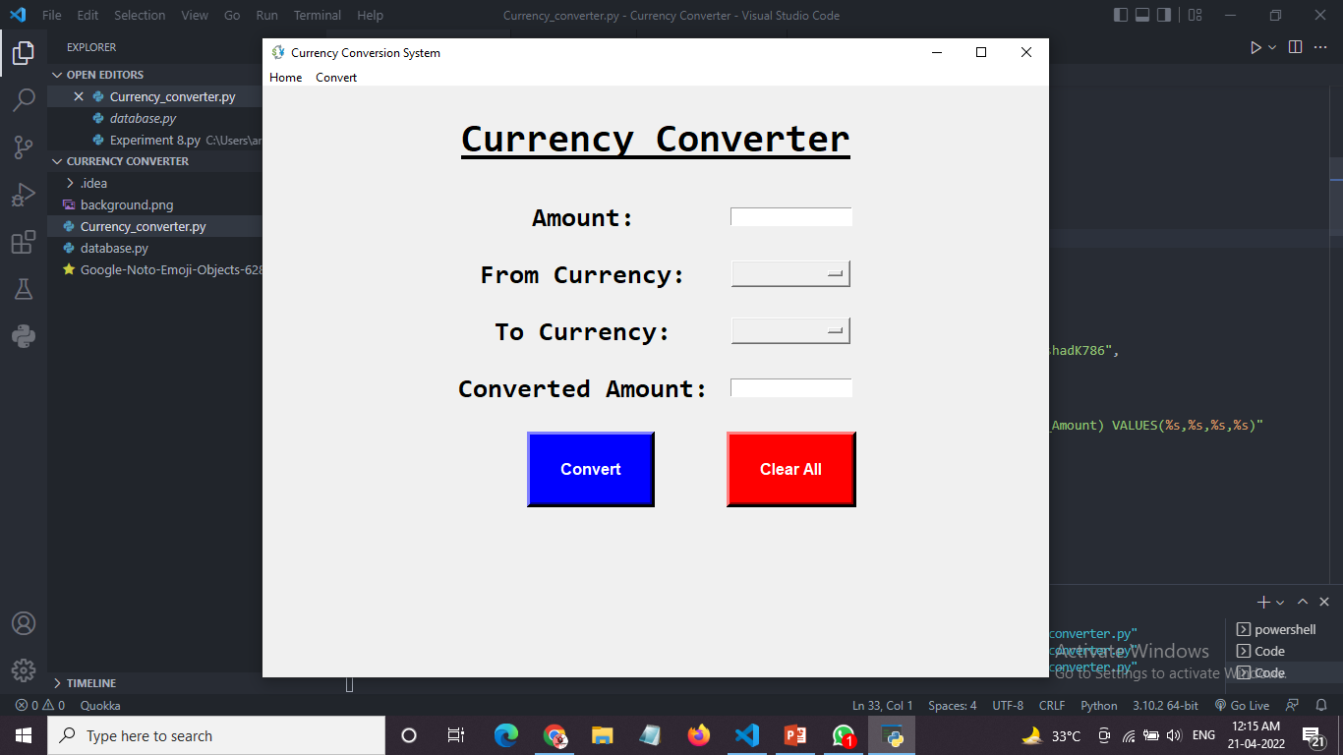

Slide 10
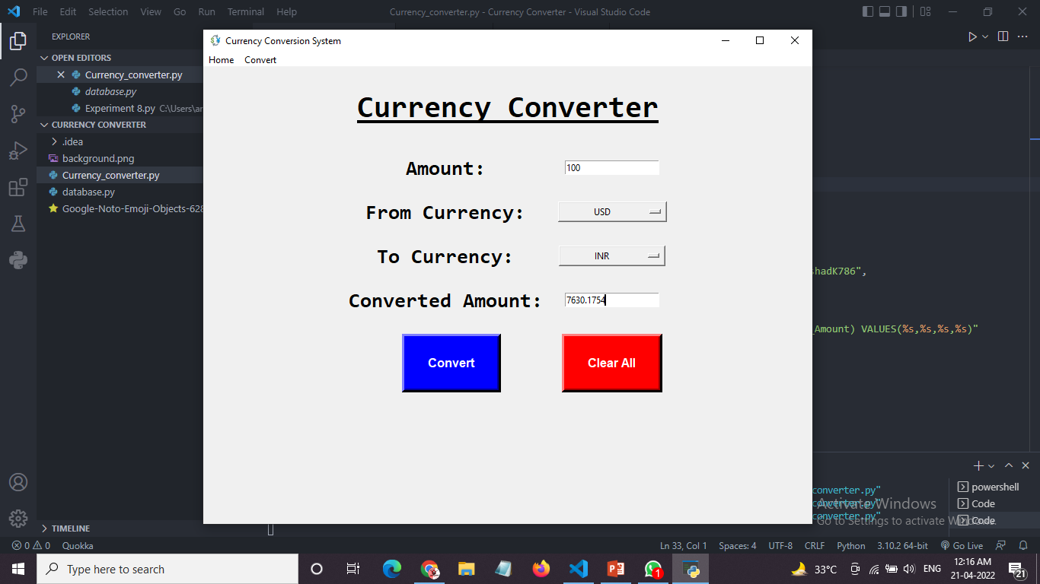

Slide 11
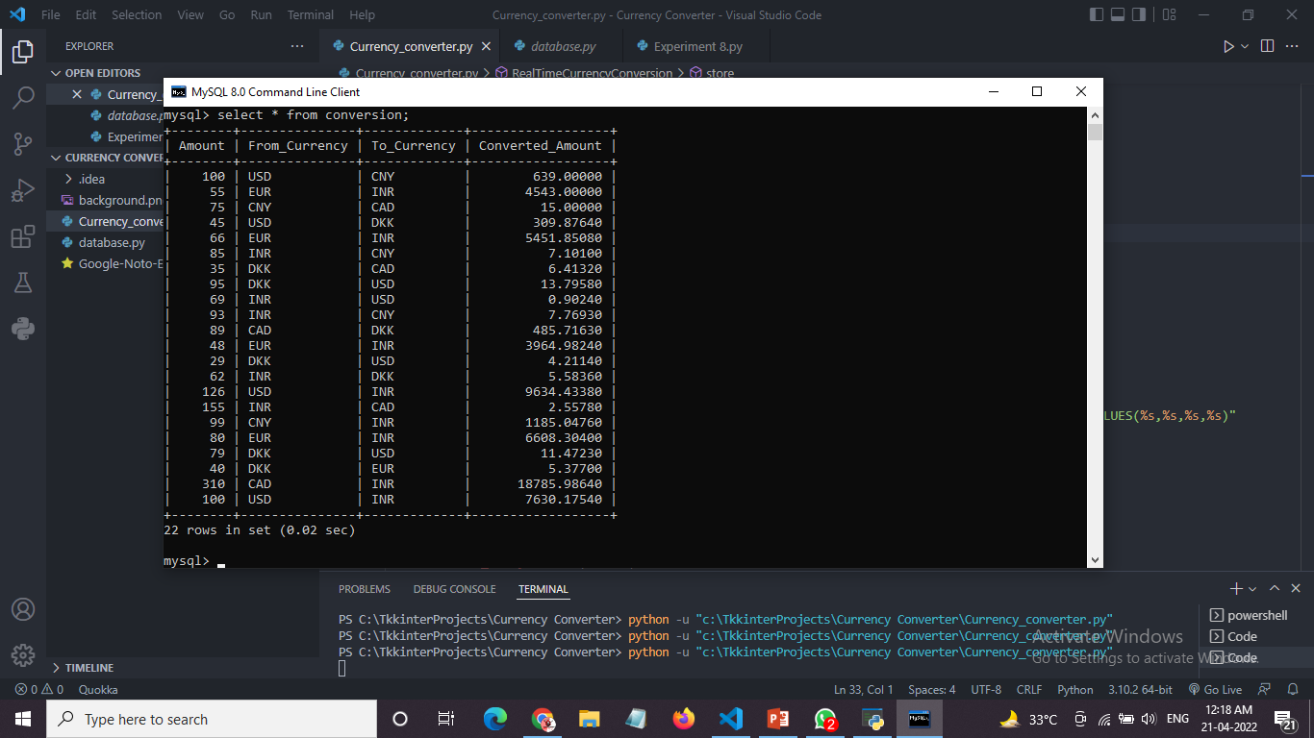

Slide 12
References
https://www.youtube.com/playlist?list=PLu0W_9lII9ajLcqRcj4PoEihkukF_OTzA
https://www.geeksforgeeks.org/python-real-time-currency-convertor-using-tkinter/

Slide 13
THANK YOU

